Slide 1
Temperature and humidity monitoring system
SUBMITTED TO:
EDUNET – UPSKILL CAMPUS,
UNICONVERGE TECHNOLOGIES Pvt Ltd.
Presented By:
Surreddy Durga Bhavani
Domain: Embedded and IoT.

Slide 2
  OBJECTIVE
Measures and record temperature and humidity levels in a specific environment.
Provide real-time data and alerts for abnormal or unsafe conditions.
Helps in maintaining a stable and optimal environment for various applications such as: Industrial processes, Laboratory experiments, Greenhouses and agricultural settings, Museums and art galleries, Residential and commercial buildings.
Provide early warnings for potential equipment failures or environmental hazards.

Slide 3
HARDWARE REQUIRE
SOFTWARE REQUIRE
Arduino Uno
ESP8266-01
DHT11
AMS1117-3.3V
9V battery
Arduino IDE Software
Proteus

Slide 4
WORKING OF DHT11 (Humidity &Temperature ) SENSOR
The DHT11 is a basic, ultra low- cost digital temperature and humidity sensor. It uses a capacitive humidity sensor and to measure the surrounding air, and spits out a digital signal on the data pin (no analog input pins needed). It is fairly simple to use, but it requires careful timing to grab data.
Temperature information from DHT11 sensor is analysed graphically on platform using Arduino MCU and ESP8266 Wi-Fi module.
The DHT11 sensor senses temperature, and sends the information to digital pin 5 of Arduino MCU, From Arduino MCU, humidity and temperature values are uploaded to the cloud at regular intervals of time through ESP8266 Wi-Fi module.
From the cloud, temperature values can be seen graphically on platform from anywhere in the world.

Slide 5
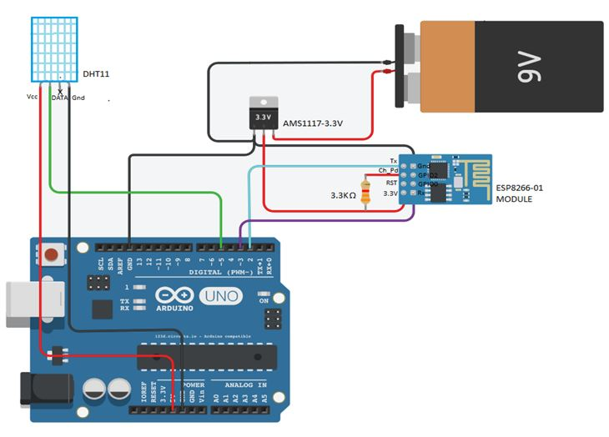
TEMPERATURE AND HUMIDITY MONITORING SYSTEM

Slide 6
BENEFITS OF TEMPERATURE MONITORING SYSTEM
Save time with instant notifications and alerts.
Productivity improvement with advanced analytics.
Maintaining regulatory compliance.
Creating transparency in the supply chain.

Slide 7
APPLICATIONS
HVAC (heating, ventilation, and air conditioning) and building management.
Server rooms and data centers.
Food storage and processing.
Pharmaceuticals and biotechnology.
Weather stations and meteorological applications.
Automotive and aerospace.

Slide 8
CONCLUSION
The use of temperature monitoring sensors has enabled the monitoring of change in temperature affecting the quality of the products.
Their implementation in different sectors has empowered the logistics and warehousing operations of a company.
A temperature and humidity monitoring system is crucial tool for various industries and applications.
It provides real-time data and alerts for abnormal conditions, helping to :- Maintain optimal environmental conditions, prevents damage and equipment failure.

Slide 9
THANK YOU

